Slide 1
Vitamin B6
Author
Institutional Affiliation
Instructor
Course code
Date of submission

Slide 2
Introduction
Vitamin B6 is also called pyridoxine.
This is a water-soluble vitamin that is naturally present in many foods, added to others and also available as a dietary supplement (McCormick, 2006).
It is essential to note that the body needs a sufficient supply of vitamin B6 to sustain regular nervous system function, production of normal red blood cells and protein metabolism.
Ideally, vitamins are needed by the body to perform specific metabolic functions.
Pyridoxine consists of three closely related compounds that include; pyridoxine (alcohol), pyridoxal (aldehyde) and pyridoxamine (amine).
This essential enzyme is mostly present in plants but is also present in animal foods. Pyridoxine is the form used in vitamin supplements because it is the least expensive to produce commercially.

Slide 3
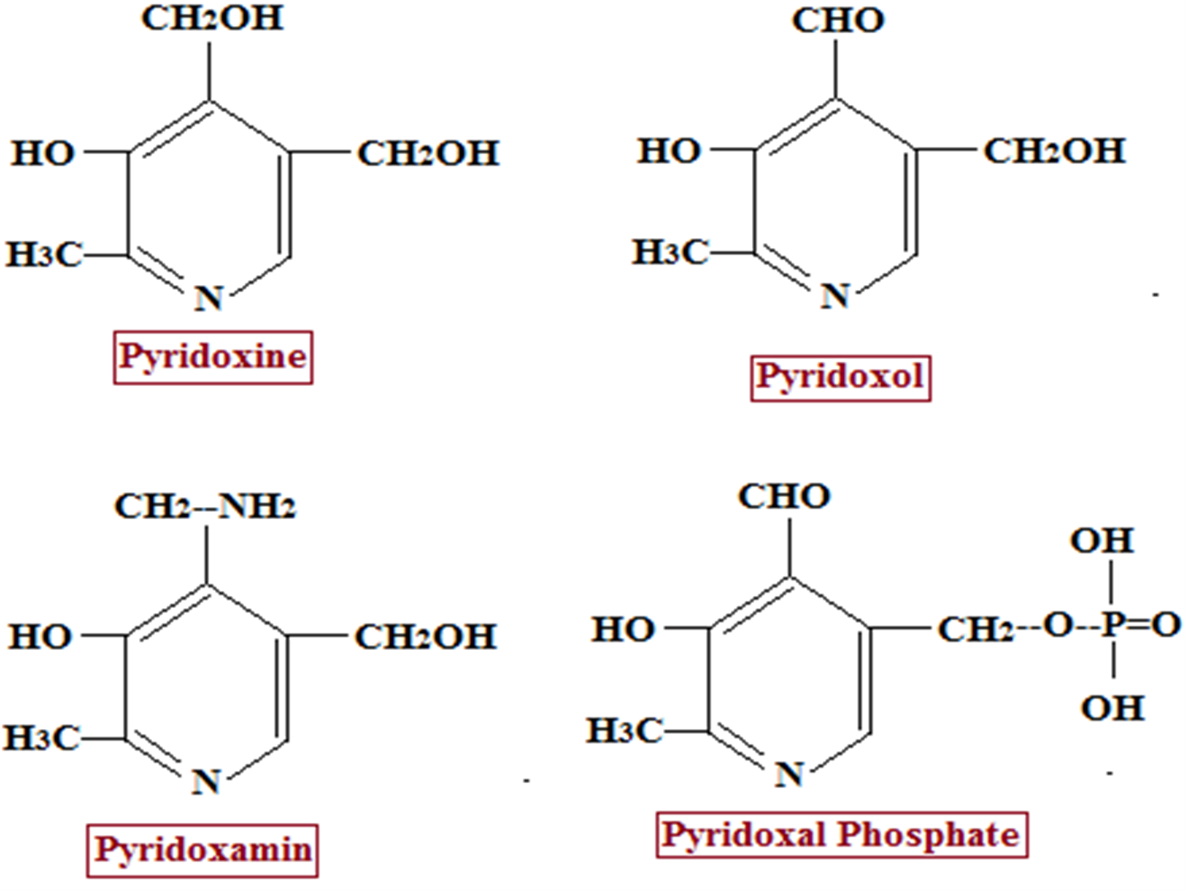
An image showing the different forms of Vitamin B6

Slide 4
Functions of vitamin B6
Vitamin B6 performs a wide variety of functions in the body and is extremely versatile.
Working closely with hundreds of other enzymes, vitamin B6 is mostly concerned with protein metabolism.
Vitamin B6 plays a significant role in cognitive development by maintaining healthy levels of homocysteine.
The vitamin is also involved in gluconeogenesis, promotes lymphocyte and interleukin production as well as hemoglobin formation.
The human body absorbs vitamin B6 in the jejunum.
It is imperative to note that phosphorylated forms of the vitamin are usually dephosphorylated and are consequently absorbed through passive diffusion.

Slide 5
Measuring the concentrations of vitamin B6
Measuring the total concentrations of vitamin B6 in the body can usually be done directly by measuring its concentrations in the plasma, erythrocytes, or even the urine (Morris et al. 2008)
Plasma concentration is considered the most common measure of vitamin B6 concentrations in the body.
Medically, concentrations of more than 30nmol/L are recommended as an adequate measure of vitamin B6 in adults.

Slide 6
Recommended intakes
The recommended intakes as recommended by the Dietary Reference Intakes range between 0.1 mg for infants to a maximum intake of 2.5 mg for adults.
Consumption of vitamin B6 beyond the tolerable maximum intakes each day might cause adverse health effects (Parra et al. 2018)
The average vitamin B6 intake is about 1.5 mg/day in women and 2 mg/day in men.
Having too much vitamin B6 beyond the recommended limits may cause painful dermatological lesions, nausea and heartburn.
Additionally, another risk associated with beyond limit consumption of this essential vitamin is the risk of severe and progressive sensory neuropathy usually characterized by loss of control of bodily movements.
Similarly, having less vitamin B6 below the recommended dietary intakes may also result in adverse consequences (Institute of Medicine. Food and Nutrition Board, 1998).
In the understanding that the body requires sufficient amounts of vitamin B6 to metabolize other different enzymes and proteins, deficiencies may result in disorders such as yeast infections, premenstrual syndrome and impaired nervous system.

Slide 7
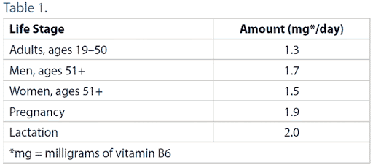
Recommended Daily Intakes for vitamin B6

Slide 8
Sources of vitamin B6
Excellent sources of vitamin B6 are generally plant-based sources such as turnip greens, shiitake mushrooms, and even spinach.
Other very good sources of vitamin B6 include garlic, tuna, cauliflower, mustard greens, tomatoes, turkey, salmon and leeks (Subar et al. 1998).

Slide 9
Body systems that require sufficient amounts of vitamin B6
Understandably, the human body needs sufficient amounts of vitamin B6 to absorb vitamin B12 and to make red blood cells and the cells of the immune system.
These important vitamins are also essential in helping the nervous system function properly (Malouf & Evans, 2003).

Slide 10
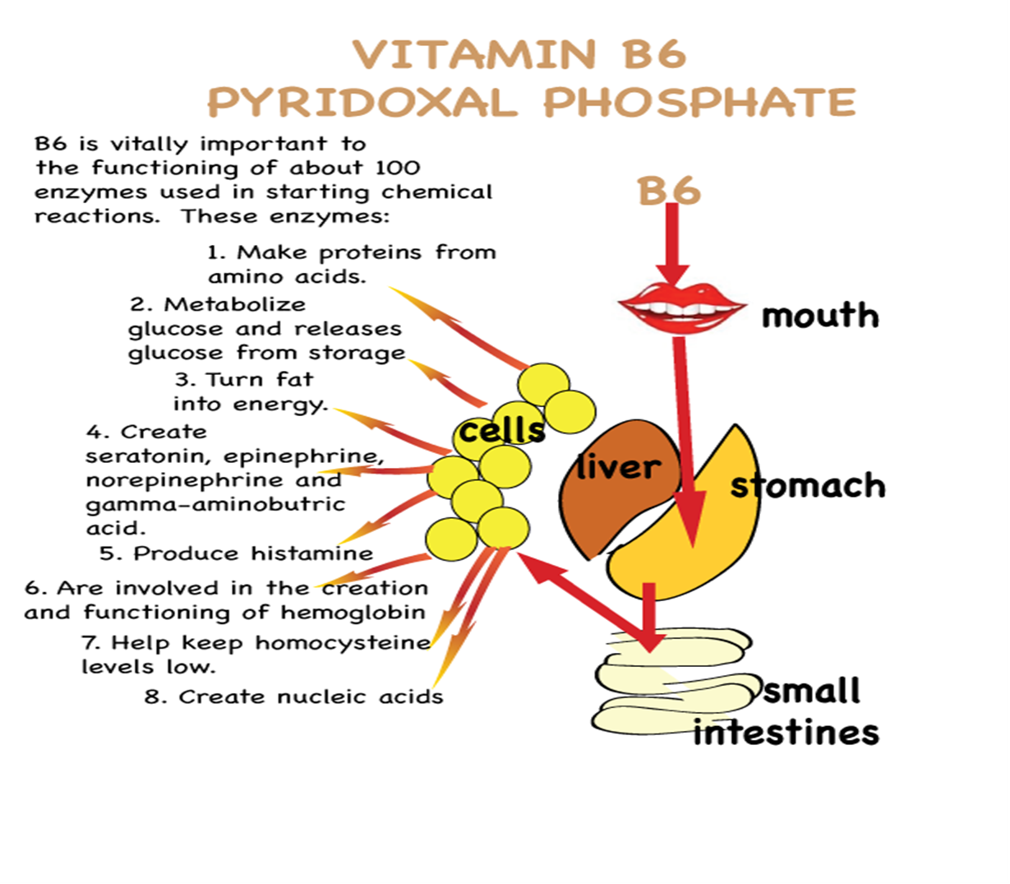
An image showing the body systems that require Vitamin B6

Slide 11
Biochemical functions
Acts as a co-transaminase: Vitamin B6 acts as a coenzyme in transmission reactions.
As a co-decarboxylase: it also functions as a coenzyme in the non-oxidative decarboxylation of some amino acids or their derivatives.
For example, Tyrosine ---------------------- Tyramine + CO2
Histidine ----------------------------- Histamine + CO2
As alanine synthase: in the synthesis of aminolaevulinic acid which is an intermediate in heme synthesis
Among other important biochemical functions include; Vitamin B6 is reported to promote the transportation of potassium ions across the cells membranes, intramitochondrial fatty acids synthesis, synthesis of sphingolipid and acts as a coenzyme for glycerin synthase.

Slide 12
Biological Active Forms
The biologically active forms of the vitamin are the phosphorylated derivatives: (Pyridoxal-PO4 and Pyridoxamine-PO4)
Phosphorylation involves the hydroxymethyl group-CH2OH at position 5 in the pyridine ring.

Slide 13
Biosynthesis
Vitamin B6 can be formed by many micro-organisms and probably also by plants. Human beings cannot synthesize the vitamin, hence has to be provided in the diet.
Intestinal bacteria can synthesize the vitamin.

Slide 14
Excretion of vitamin B6
Pyridoxal and Pyridoxamine are excreted in the urine in small amounts 0.5to o.7 mg daily.
Major urinary metabolite: inactive form 4-pyridoxic acid.
It a useful clinical marker to assess the vitamin B6 status of an individual

Slide 15
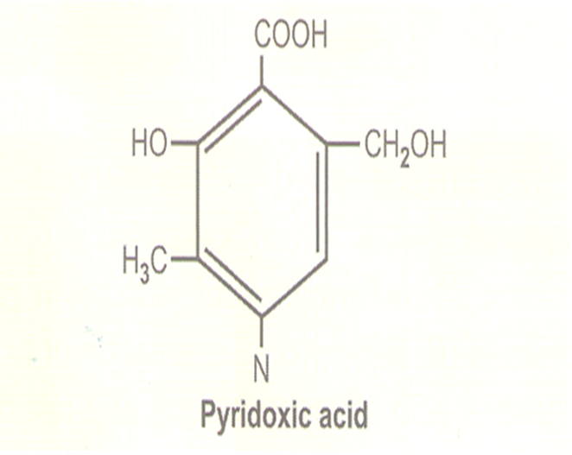
Major urinary metabolite: inactive form 4-pyridoxic acid

Slide 16
Other important information regarding vitamin B6
Cooking, storage and processing of foods containing vitamin B6 can result in significant losses of vitamin B6 by more than 50%.
However, this is usually dependent on the amounts of vitamin present in the food source.
Plant foods lose the least during processing, as they contain mostly pyridoxine, which is far more stable than the Pyridoxal or pyridoxamine found in animal foods.
Similarly, it is essential to note that freezing and canning of foods may also result in the loss of vitamin B6 in foods.

Slide 17
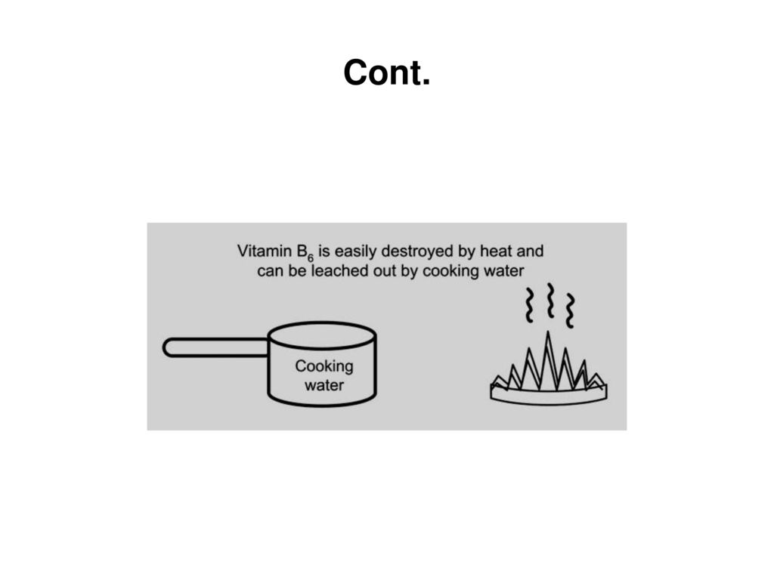

Slide 18
References
Malouf, R., & Evans, J. G. (2003). Vitamin B6 for cognition. Cochrane Database of Systematic Reviews, (4).
Meydani, S. N., Ribaya-Mercado, J. D., Russell, R. M., Sahyoun, N., Morrow, F. D., & Gershoff, S. N. (1991). Vitamin B− 6 deficiency impairs interleukin 2 production and lymphocyte proliferation in elderly adults. The American journal of clinical nutrition, 53(5), 1275-1280.
Parra, M., Stahl, S., & Hellmann, H. (2018). Vitamin B6 and its role in cell metabolism and physiology. Cells, 7(7), 84.

Slide 19
McCormick D. Vitamin B6. In: Bowman B, Russell R, eds. Present Knowledge in Nutrition. 9th ed. Washington, DC: International Life Sciences Institute; 2006.
Morris MS, Picciano MF, Jacques PF, Selhub J. Plasma pyridoxal 5’-phosphate in the US population: the National Health and Nutrition Examination Survey, 2003-2004. Am J Clin Nutr 2008;87:1446-54
Institute of Medicine. Food and Nutrition Board. Dietary Reference Intakes: Thiamin, Riboflavin, Niacin, Vitamin B6, Folate, Vitamin B12, Pantothenic Acid, Biotin, and Cholineexternal link disclaimer. Washington, DC: National Academy Press; 1998
Subar AF, Krebs-Smith SM, Cook A, Kahle LL. Dietary sources of nutrients among US adults, 1989 to 1991. J Am Diet Assoc 1998;98:537-47.

